Slide 1
Manufacturing Technology (ME461)
Date: 18/1/2018
Instructor: Shantanu Bhattacharya

Slide 2
Bezier Curves
The Hermite curve discussed in the previous section is based on interpolation techniques.
On the contrary, Bezier curves are based on approximation techniques that produce curves which do not pass through all the given data points except the first and the last control point.
A Bezier curve does not require first order derivative; the shape of the curve is controlled by control points.

Slide 3
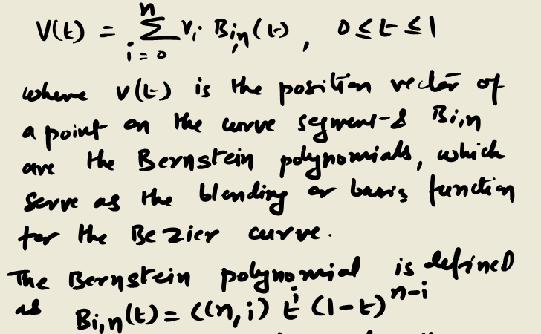
Bezier Curves
As in the previous section, we consider here one segment of the curve.
For n+1 control points, the Bezier curve is defined by a polynomial of degree n as follows:

Slide 4
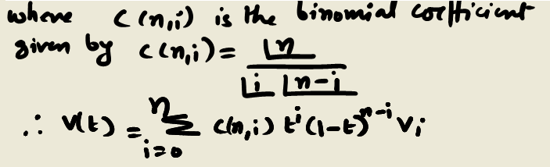
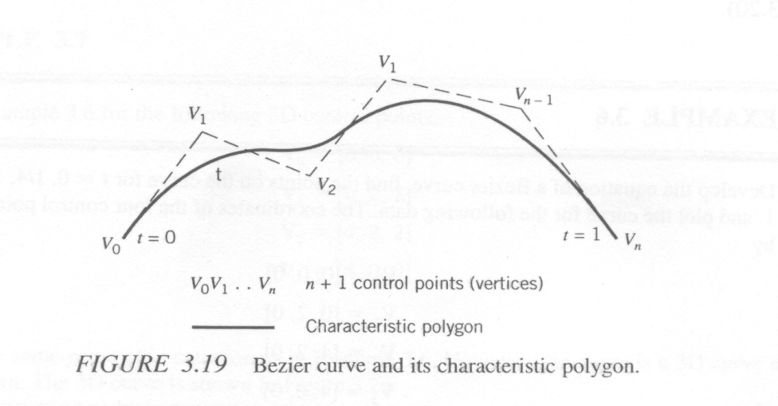
Bezier Curves
Here V₀, V₁, ……. V_{n} are position vectors of n+1 points (V₀, V₁, ……. V_{n} in Figure 3.19) that form the so-called characteristic polygon of the curve segment.

Slide 5
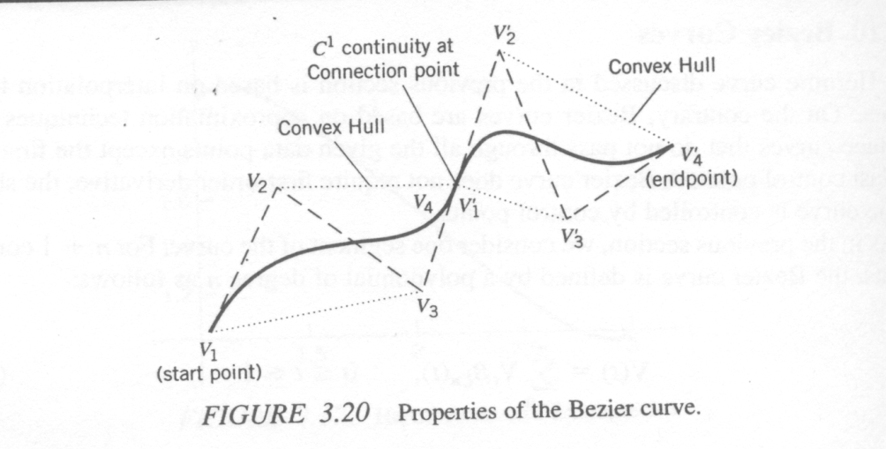
Properties of Bezier Curves
The curves pass through the first and last control points (V₀ and V_{n} from the preceding function) at parameter values 0 and 1. In the figure on the left the starting point V₁’ of the second line and the endpoint V₄ of the first line have the same position.
The tangents at the first and last points are in the directions of the first and last segments of the characteristic polygon. This can easily be seen:
V’(0) = n [V(1)-V(0)], V’(1) = n [V(n)-V(n-1)]
Where [V(1) – V(0)] and [V(n)-V(n-1)] define the first and last segments of the curve polygon. This implies that by aligning the last control point of the first Bezier curve segment, the connection point, and the first control point of the next curve segment will result in C¹ continuity between the two curve segments.

Slide 6
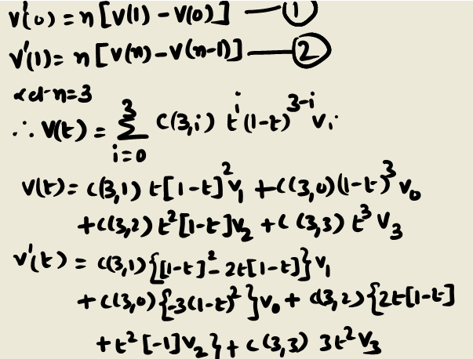
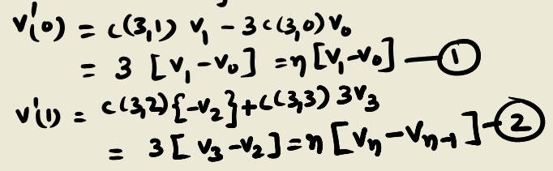
Proof of the V’(0) and V’(1) values
The Bezier curve has the convex hull property. By convex hull property we mean that the entire curve lies within the characteristic polygon. This property is useful when curve intersection and spatial bounds on the curve segments are calculated.

Slide 7
Example problem
Develop the equation of a Bezier curve, find the points on the curve for t = 0, ¼, ½, ¾, and 1, and plot the curve for the following data. The coordinates of the four control points are given by:
V0 = [0,0,0], V1= [0,2,0], V2= [4,2,0], V3= [4,0,0]

Slide 8
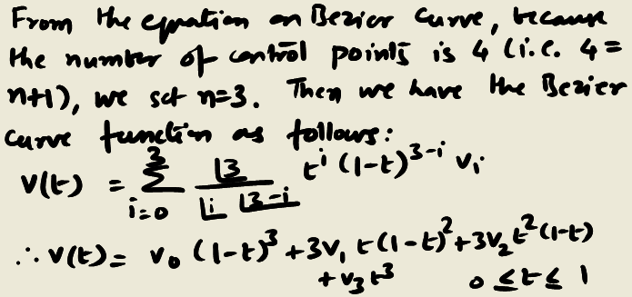
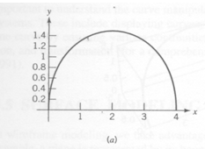
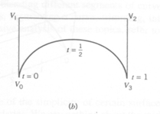
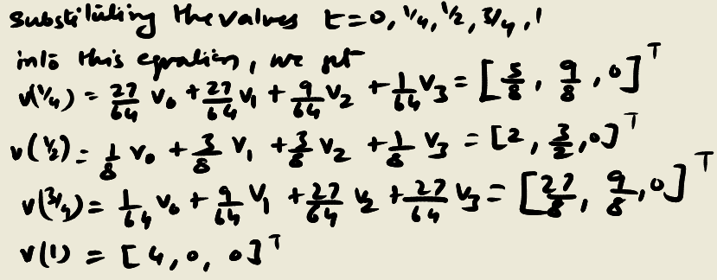

Solution

Slide 9
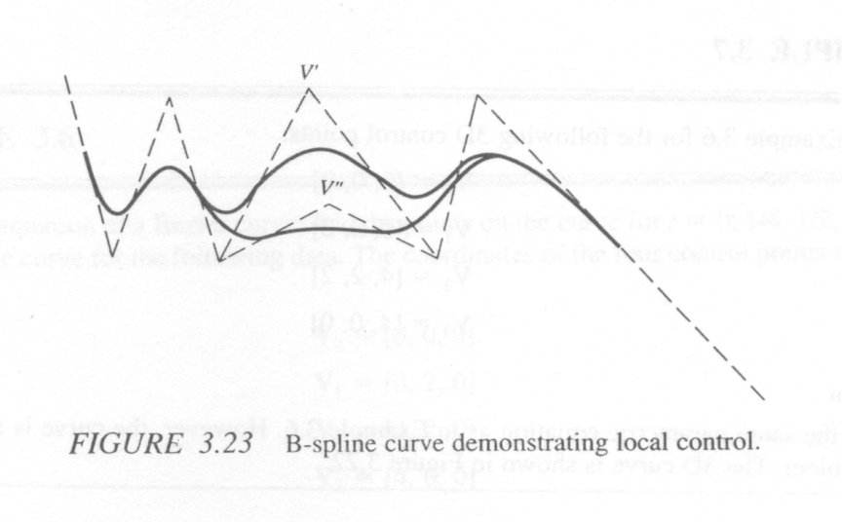
B-Spline, Rational B-Spline, and Non uniform rational B-Spline curves
The B-Spline is considered a generalization of the Bezier curve.
Local control is an interesting feature of B-Spline curves which implies that any change in the local control point affects only part of the curve.
Rational B-splines are generalizations of B-Splines. Interestingly, an RBS has an added parameter (called a weight) associated with each control point to control the behavior of the curve.

Slide 10
Surface Modeling
In wireframe modeling, we take advantage of the simplicity of certain surfaces. For example a plane is represented by its boundaries. We say nothing about the middle of the plane, which is fine because we known that the middle of a plane is till a plane.
It is common knowledge that the shapes of the cars, aircrafts and ships are very complex and do not consist of simple and regular geometric shapes. So, it is not easy to represent them by wireframe models and so surface modeling is prefered.
Surface modeling system contains definition of surfaces, edges and vertices. It contains all the information that a wireframe does and in addition it also contains the information of how the two surfaces connect to each other.

Slide 11
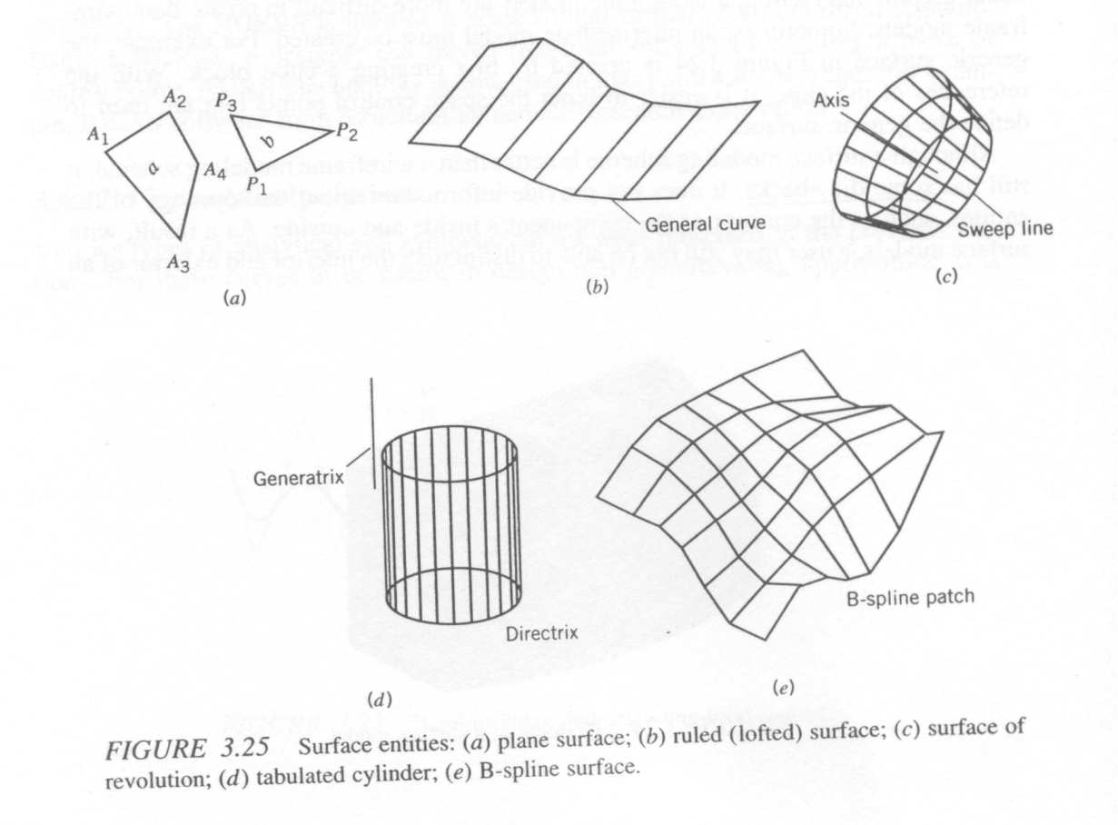
Surface entities
Plane surface:
A plane surface is the simplest surface that is defined by three non coincident points or its variation.
Ruled Surface:
A ruled surface can be defined as the linear interpolation between two general curves. Informally the straight lines connecting the two rails form the surface.
Surface of revolution: This surface is generated by rotating a planar curve in space about an axis at a certain angle.
Tabulated cylinder: This surface is generated by sweeping a planar curve in space in a certain direction at a certain distance. In the example above a straight line sweeps about a path that is circle and forms the surface. The straight line is called the generatrix and the circle is the directrix.
Bezier surface and B-Spline surface: Bezier and B-spline surfaces are both synthetic surfaces. Like synthetic curves a synthetic surface approximates the given input data. The Bezier and B-Spline surfaces are also formed in the same manner as the 2D curves.

